Slide 1
Ingest and load data into the data warehouse

Slide 2
Agenda
Dedicated SQL pools in Azure Synapse Analytics
Data loading best practices in Azure Synapse Analytics
Petabyte-scale ingestion with Synapse Pipelines
Notes:
TALKING POINTS
Let’s set an agenda for today’s presentation in which we are going to discuss these topics.
PRESENTER NOTES AND GUIDANCE
Don’t take too much time in order to present the agenda. Make the points in the topics.

Slide 3
I might have missed it, but… what are dedicated SQL pools again?
1
Notes:
Move to “Ingest and load data into the data warehouse” presentation

Slide 4
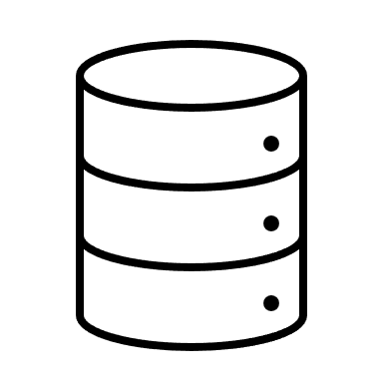
Azure Synapse dedicated SQL pools
Dedicated SQL Pools refers to the enterprise data warehousing feature available in Azure Synapse Analytics. Dedicated SQL Pools represent the dedicated compute resources required to process data loads and queries for relational big data workloads. The size of SQL pool is determined by Data Warehousing Units (DWU).
Notes:
Think of dedicated SQL pools as being the data warehouse part of Synapse. They represent the massively parallel processing (MPP) part of the equation and replace the functionality of the older Azure SQL Data Warehouse product.

Slide 5
Comparing dedicated SQL Pools with serverless SQL pools in Azure Synapse Analytics
Dedicated SQL Pool
Serverless SQL Pool
Used for Data Warehouse operations
Provides predictable performance and costs
Reserves processing power for data stored in SQL tables
Used for data preparation or ad-hoc queries against unstructured data.
Provides an always available SQL endpoint for unplanned workloads
Enables interactive querying
Notes:
TALKING POINTS
Synapse SQL offers both serverless and dedicated resource models, offering consumption and billing options to fit your needs. For predictable performance and cost, provision pools to reserve processing power for data stored in SQL tables. For unplanned or bursty workloads, use the serverless, always-available SQL endpoint.
PRESENTER NOTES AND GUIDANCE
Review:
What is Azure Synapse Analytics:
https://docs.microsoft.com/en-us/azure/synapse-analytics/overview-what-is

Slide 6
Data loading best practices in Azure Synapse Analytics
2
Notes:
TALKING POINTS
Let’s go over data loading best practices in Azure Synapse Analytics. How many of you have the need to explore data, or perform ad hoc transformation?
PRESENTER NOTES AND GUIDANCE
Poll your audience.

Slide 7
Data loading best practices in Azure Synapse Analytics
Manage source data files
Manage singleton updates
Set up dedicated data loading accounts
Manage concurrent access to Azure Synapse Analytics
Implement Workload Management
Use PolyBase, the Copy command, or the Copy data activity in Synapse Pipelines
Notes:
Talking points
The first two best practices are straight forward. Splitting a large file into smaller files takes advantage of the parallelism provided by the Massively Parallel Processing (MPP) architecture within Azure Synapse Analytics dedicated SQL pools. Managing singleton updates to develop one process that writes the outputs of an INSERT statement to a file, and then another process to periodically load this file also takes advantage of the parallelism that Azure Synapse Analytics has.
The second two points manage concurrent access to the system to optimize the data loads. Setting up a dedicated data loading account, assigned to different resource classes dependent on the anticipated task will optimize load performance and maintain concurrency as required by managing the available resource slots available within the dedicated SQL Pool. Also reducing or minimizing the number of simultaneous load jobs at the same time manages the concurrent access to Azure Synapse Analytics
If bullet points three and four are difficult to implement, then bullet point 5 could help. If you are unable to minimize the amount of concurrent load jobs, or allocate fixed resources to a workload group. You can assign maximum and minimum usage for varying resources under load. These adjustments can be done live without having to take Azure Synapse Analytics offline, and provides the following benefits:
Reserve resources for a group of requests
Limit the amount of resources a group of requests can consume
Shared resources accessed based on importance level
Setting the Query timeout value reduces the need for DBAs to runaway queries
Exercise 1 of the lab focuses on the final bullet, specifically using PolyBase, and the Copy command, and you can share your own example or example of these from the lab
Instructor notes and guidance.
You will spend about 15 minutes discussing some of the best practices on this slide. It is an important aspect of creating a scalable data warehousing solution. What is covered here are the more common best practise that we have observed with customers, there are others that you can add yourself from the following URL Data loading best practices - Azure Synapse Analytics | Microsoft Docs
Recommended reading for this slide
Use data loading best practices in Azure Synapse Analytics - Learn | Microsoft Docs

Slide 8
What is PolyBase?
Query data from its original location and format
Enables SQL Server to query external data using T-SQL
Join data from external sources to relational tables
Minimizes the need for ETL processes for data movement
Notes:
PolyBase enables your SQL Server instance to query data with T-SQL directly from SQL Server, Oracle, Teradata, MongoDB, Hadoop clusters, Cosmos DB without separately installing client connection software. You can also use the generic ODBC connector to connect to additional providers using third-party ODBC drivers. PolyBase allows T-SQL queries to join the data from external sources to relational tables in an instance of SQL Server.
https://docs.microsoft.com/en-us/sql/relational-databases/polybase/polybase-guide?view=azure-sqldw-latest

Slide 9
COPY Statement (T-SQL)
Query data from its original location and format
Enables Azure Synapse Analytics to query and load external data using T-SQL
Provides the most flexibility for high-throughput data ingestion into Azure Synapse Analytics
Uses lower privileged accounts to load data
Notes:
https://docs.microsoft.com/en-us/sql/relational-databases/polybase/polybase-guide?view=azure-sqldw-latest

Slide 10
Differences between PolyBase and the COPY statement
PolyBase
COPY statement
Needs CONTROL permission
How row width limits
No delimiters within text
Fixed line delimiter
Complex to set up in code
Relaxed permission
No row width limit
Supports delimiters in text
Supports custom column and row delimiters
Reduces amount of code
Notes:
TALKING POINTS
TODO: Add speaking points for this slide
PRESENTER NOTES AND GUIDANCE
Review:
https://docs.microsoft.com/en-us/azure/synapse-analytics/data-integration/concepts-data-factory-differences

Slide 11
Petabyte-scale ingestion with Azure Data Factory/Synapse Pipelines
3
Notes:
Talking Points:
Let’s look at how you can ingest data at petabyte-scale using Azure Data Factory or Synapse Pipelines.

Slide 12
What is Azure Data Factory?
Cloud-based ETL and data integration service
Service to orchestrate and operationalize data movement and ingestion processes
Allows you to create data-driven workflows for orchestrating data movement and transforming data at scale
Ingest data from disparate data stores
Build complex ETL/ELT processes for transforming data
Notes:
In the world of big data, raw, unorganized data is often stored in relational, non-relational, and other storage systems. However, on its own, raw data doesn't have the proper context or meaning to provide meaningful insights to analysts, data scientists, or business decision makers.
Big data requires a service that can orchestrate and operationalize processes to refine these enormous stores of raw data into actionable business insights. Azure Data Factory is a managed cloud service that's built for these complex hybrid extract-transform-load (ETL), extract-load-transform (ELT), and data integration projects.
Azure Data Factory is the platform that solves such data scenarios.

Slide 13
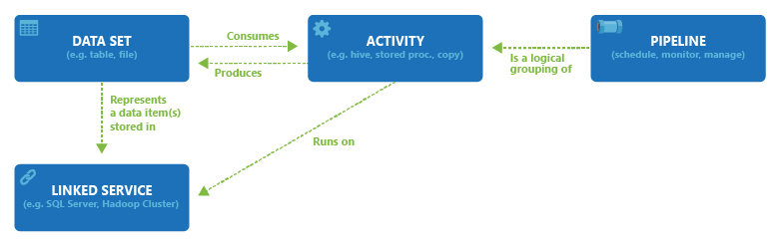
ADF Terminology
Linked Services
Data Sets
Activities
Pipelines
Integration Runtimes
Notes:
Linked Services: Link a data store to Azure Data Factory or Synapse Pipelines. Very much link connection strings. They define the connection information needed for the service to connect to external references.
Data sets: A data set is a named view of data that simply points or reference the data you want to use in your activities.
Activities: Define the actions to perform on your data.
Pipelines: Logical grouping of activities that together perform a task

Slide 14
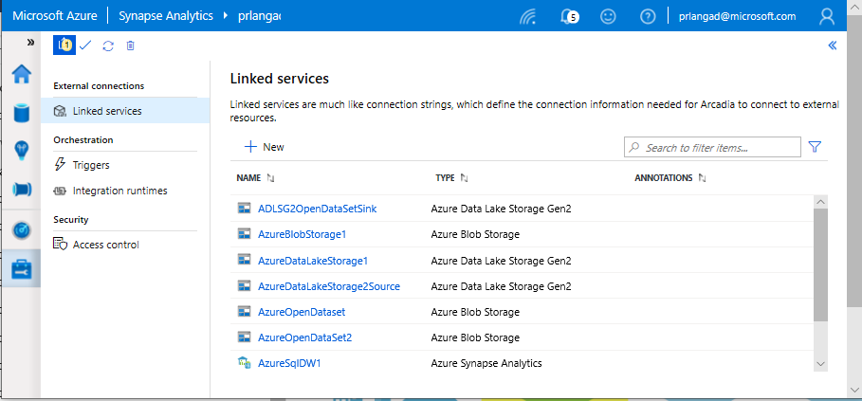
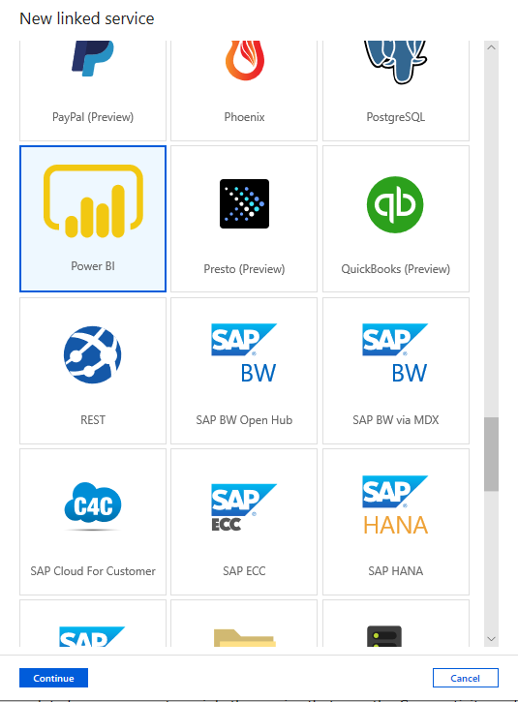
Linked services
Overview
Linked services define the connection information needed to connect to external resources.
Benefits
Offers pre-built 95+ connectors
Easy cross-platform data migration
Represents data store or compute resources

Slide 15
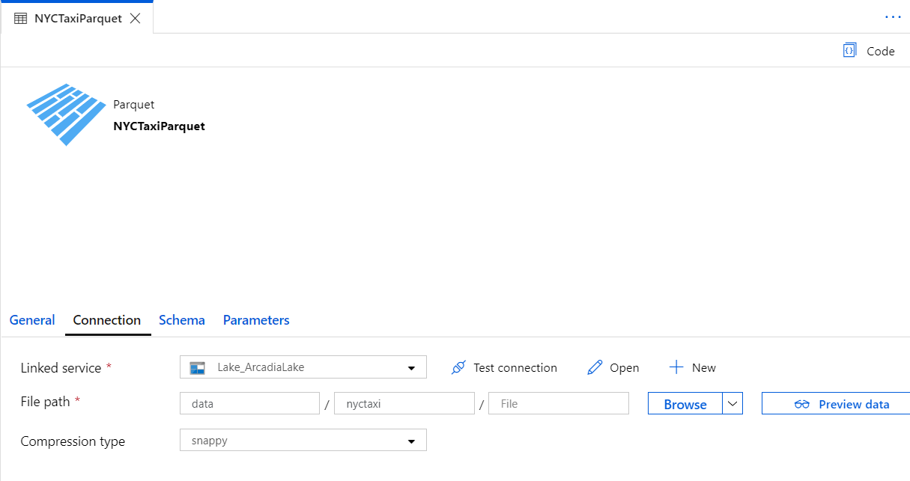
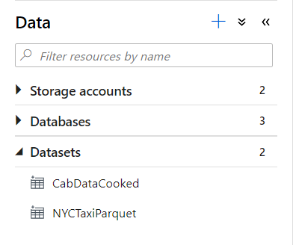
Datasets
Orchestration datasets describe data that is persisted.
Once a dataset is defined, it can be used in pipelines and sources of data or as sinks of data.

Slide 16
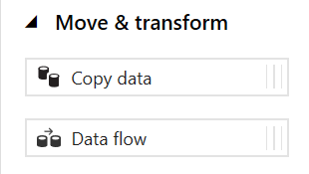
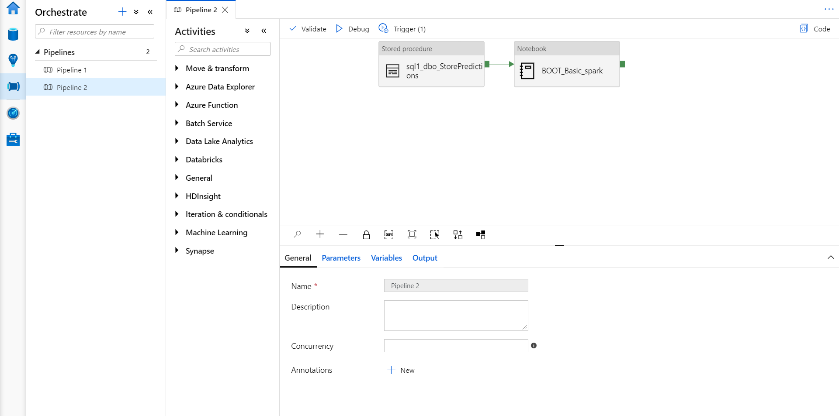
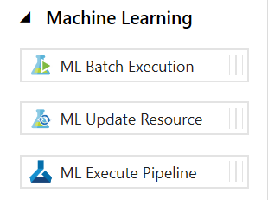
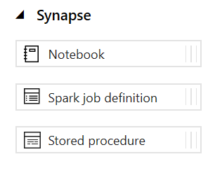
Pipelines
Notes:
Create pipelines to ingest, transform and load data with 95+ inbuilt connectors.
Pipelines offer a wide range of activities that they can perform.
They provide ability to load data from a storage account or other connectors to the desired linked service.
You can load data by manual execution of the pipeline or by orchestration.
Benefits
Pipelines support common loading patterns and provide fully parallel loading into the data lake or SQL tables.
All of this is done through a graphical development experience.

Slide 17
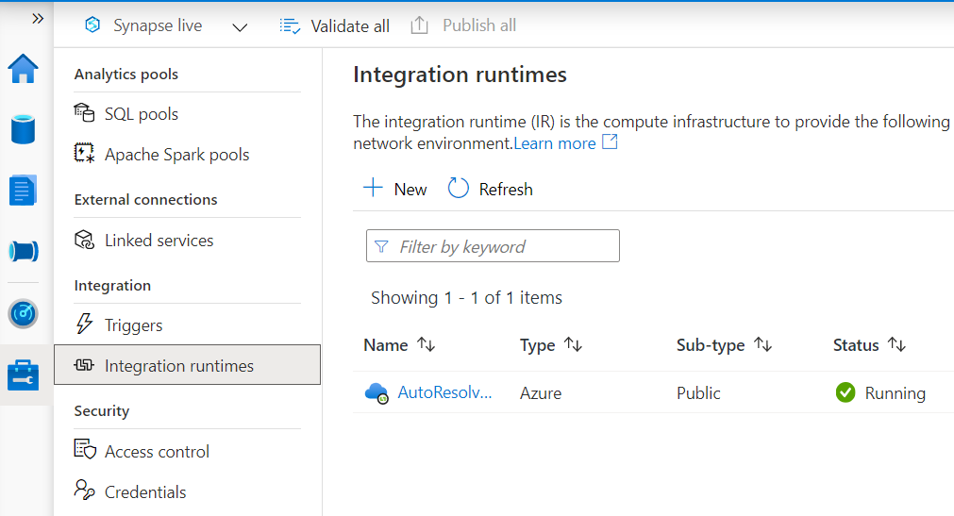
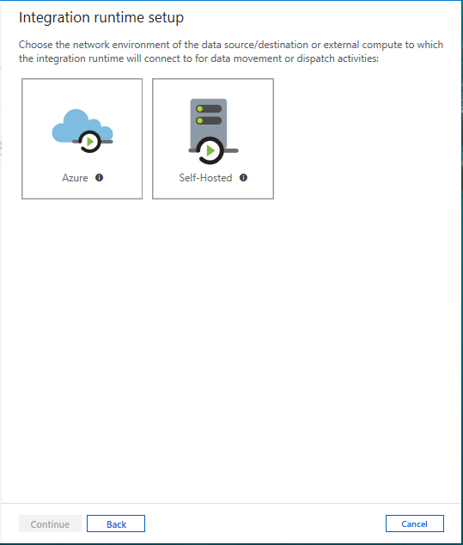
Integration runtimes
Overview
Integration runtimes are the compute infrastructure used by Pipelines to provide the data integration capabilities across different network environments. An integration runtime provides the bridge between the activity and linked services.
Benefits
Offers Azure Integration Runtime or Self-Hosted Integration Runtime
Azure Integration Runtime – provides fully managed, serverless compute in Azure
Self-Hosted Integration Runtime – use compute resources in on-premises machine or a VM inside private network
Notes:
Need to explain and why needed
Check with Gaurav

Slide 18
Comparing Azure Data Factory with Synapse Pipelines
Azure Data Factory
Synapse Pipelines
Allows use of SSIS and SSIS Integration Runtime and SSIS package activity
Supports Cross-region Integration Runtime (Data Flows)
Integration Runtime sharing across different data factories
Provides support for Power Query Activity
Monitoring of Spark jobs for Data Flows leveraging Synapse Spark pools
Notes:
TALKING POINTS
Before looking at petabyte-scale ingestion, lets quickly compare Azure Data Factory with Synapse Pipelines. ADF and Synapse Pipelines are essentially the same product, and they share the same code base. However, there are a few differences you should be aware of, most notably that Synapse Pipelines does not allow the use of the SSIS Integration Runtime.
PRESENTER NOTES AND GUIDANCE
Review:
https://docs.microsoft.com/en-us/azure/synapse-analytics/data-integration/concepts-data-factory-differences

Slide 19
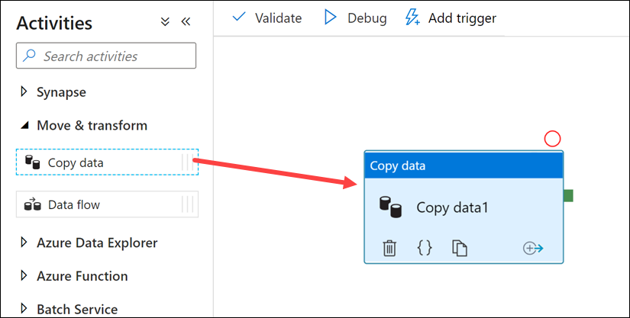
Petabyte-scale ingestion with the Copy data activity
Notes:
Talking points
The Copy Data Activity provides a method for building code-free data ingestion pipelines that do not require any transformation during the extraction of the data. The Copy Activity has support for over 100 native connectors. This method can suit new start-up projects that have a simple method of extraction to an intermediary data store. An example of ingesting data using the Copy Activity can include extracting data from multiple source database systems and outputting the data to files in a data lake store.
The Copy activity performs the following steps:
Reads data from a source data store.
Performs serialization/deserialization, compression/decompression, column mapping, and so on. It performs these operations based on the configuration of the input dataset, output dataset, and Copy activity.
Writes data to the sink/destination data store
Instructor notes and guidance.
You may want to consider running a simple demo of the copy activity yourself to show how to setup the copy activity in Azure Data Factory/Azure Synapse pipelines. Inform the students that they will get to explore the Copy Activity in exercise 2 of the lab.
Recommended reading for this slide
Use data loading best practices in Azure Synapse Analytics - Learn | Microsoft Docs

Slide 20
PolyBase vs COPY
PolyBase
COPY
Relaxed permission
No row width limit
Supports delimiters in text
Supports custom column and row delimiters
GA, stable
Needs CONTROL permission
Enables querying via external tables
Challenges:
Row width (1 MB)
Delimiters in text
Fixed line delimiter
Code complexity
Notes:
To use PolyBase, the user that loads data into Azure Synapse Analytics must have "CONTROL" permission on the target database. One way to achieve that is to add the user as a member of the db_owner role
PolyBase loads are limited to rows smaller than 1 MB. It cannot be used to load to VARCHR(MAX), NVARCHAR(MAX), or VARBINARY(MAX).

Slide 21
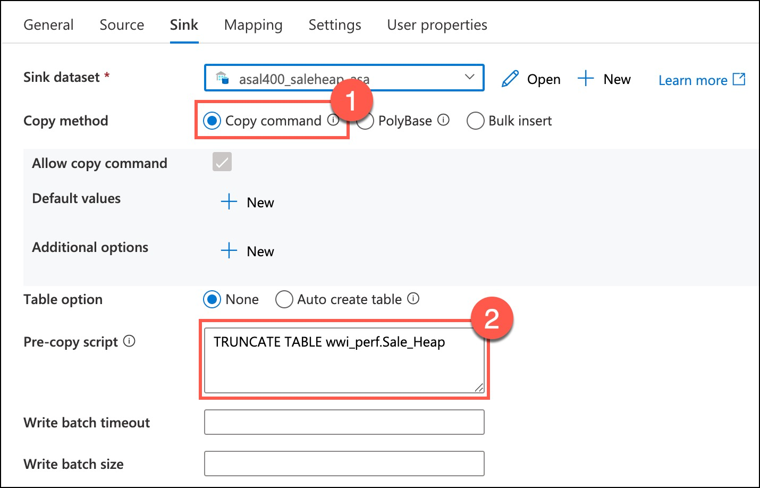
Copy Activity

Slide 22
LAB 5: Ingest and load data into the data warehouse
60 minutes
Notes:
TALKING POINTS​
​
Let’s put this into reality and show you how it works.​
​
This lab teaches students how to ingest data into the data warehouse through T-SQL scripts and Synapse Analytics integration pipelines. The student will learn how to load data into Synapse dedicated SQL pools with PolyBase and COPY using T-SQL. The student will also learn how to use workload management along with a Copy activity in a Azure Synapse pipeline for petabyte-scale data ingestion.
In exercise one, you will explore loading data by using Transact-SQL statements, and deliberately compare PolyBase and the Copy command so that the student get to see for themselves which method they would like to use. Code is provided in the lab, but you may want to take students who are less familiar with T-SQL through the code, so they understand how it work. Exercise 2 begins by exploring the data loading best practice of working with workload management so that you can manage the priority of a data load. They then move onto the Copy Activity to simplify data ingestion, and deep dive into the settings that are required to set this up successfully.

